Slide 1
HPC for the Greek Health and Life Sciences Sector
EuroCC Thematic Event
ICS-FORTH & PRAXIS Network
June 17th

Slide 2
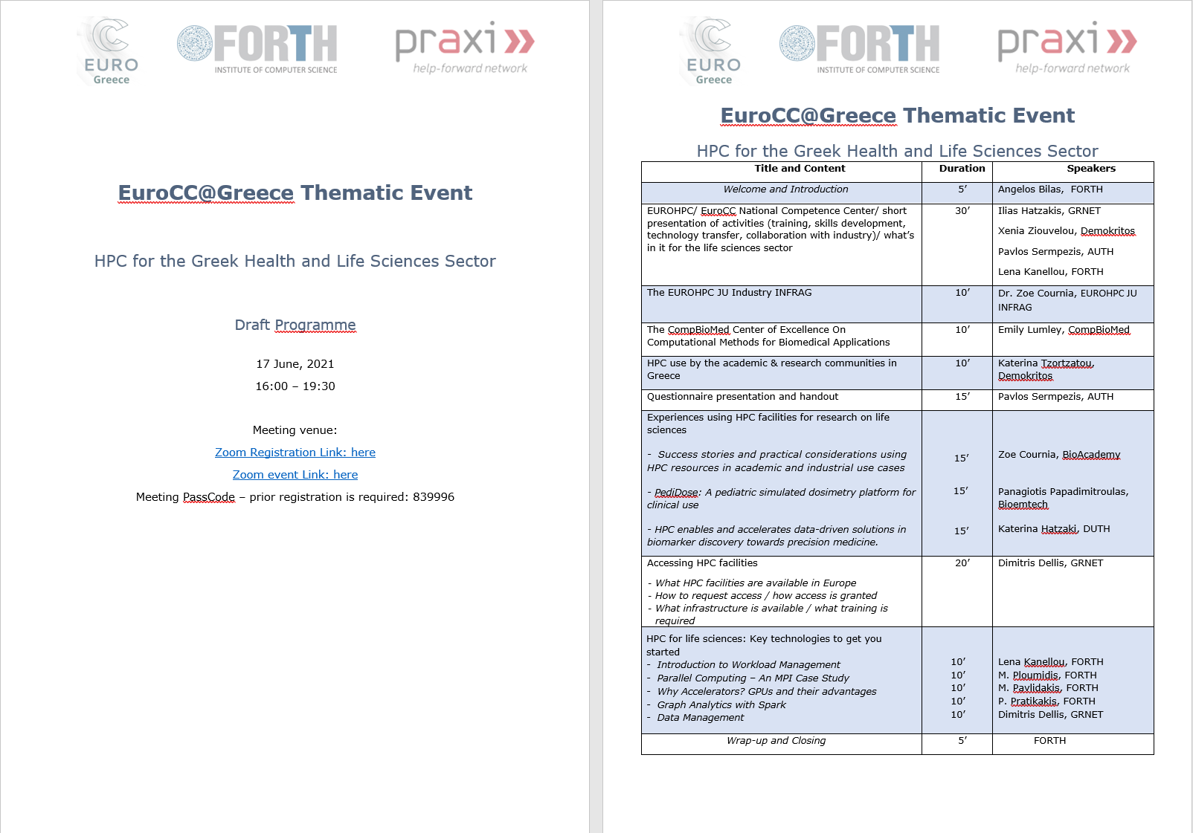

Slide 3
HPC for the Greek Health and Life Sciences Sector
EuroCC Thematic Event
ICS-FORTH & PRAXIS Network, June 17th
EUROHPC JU/ EuroCC National Competence Centers/ EuroCC@Greece
Ilias Hatzakis – GRNET
Xenia Ziouvelou – Demokritos
Pavlos Sermpezis – AUTH
Lena Kanellou - FORTH / PRAXI

Slide 4
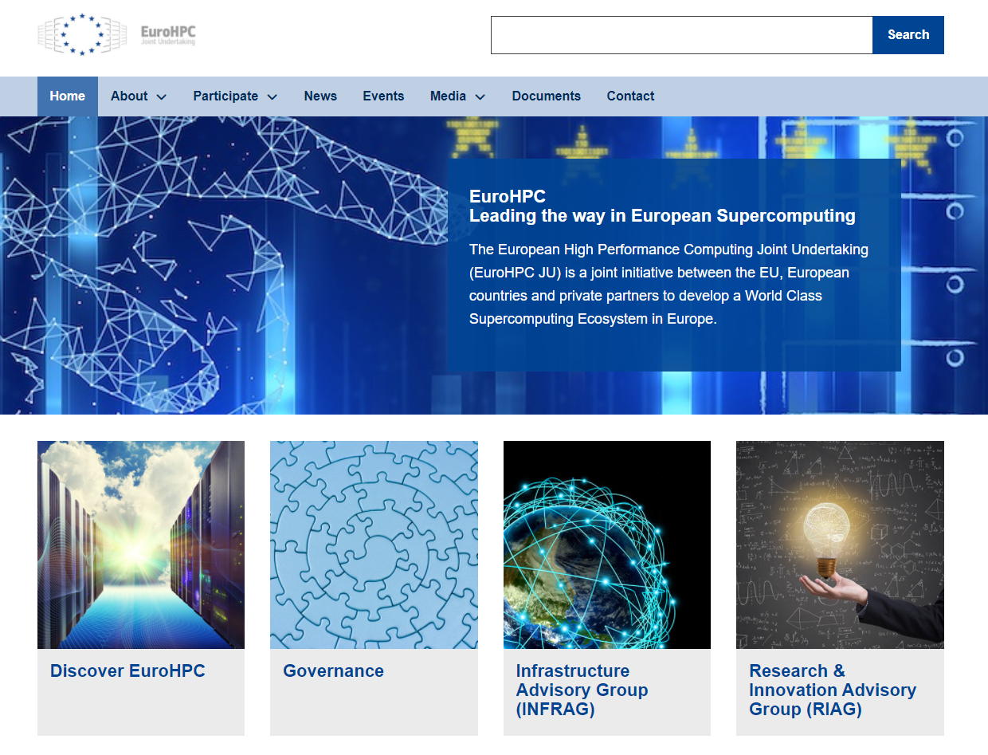
The EuroHPC Joint Undertaking
Created in 2018
Aims to make Europe a world leader in high performance computing (HPC)
Develops a world-class supercomputing infrastructure, available to Europe's private and public users, scientific and industrial users everywhere in Europe
Stimulates a technology supply industry (from low-power processors to software and middleware, and their integration into supercomputing systems)
Supports research and innovation activities: developing and maintaining an innovative European supercomputing ecosystem, with emphasis to SMEs
eases access to European HPC opportunities in different industrial sectors, delivering tailored solutions for a wide variety of users.
Strengthens the European knowledge base in HPC technologies and bridging the digital skills gap

Slide 5
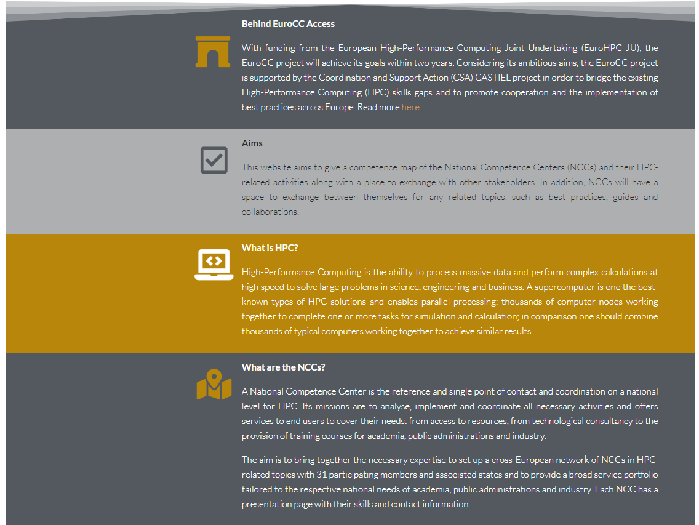
The EuroCC Network
Each of the 33 national competence centres, which will be part of the EuroCC network, will act locally to map available HPC competencies and identify existing knowledge gaps. The competence centres will coordinate HPC expertise at national level and ease access to European HPC opportunities for research and scientific users, public administration but also in different industrial sectors, delivering tailored solutions for a wide variety of users.
The ultimate objective of the projects is to ensure a coordinated and consistent high level of expertise across Europe in HPC and related disciplines such as high-performance data analytics (HPDA) and artificial intelligence. Such European knowledge and expertise are key to strengthen the European Union (EU) technological autonomy and competitiveness

Slide 6
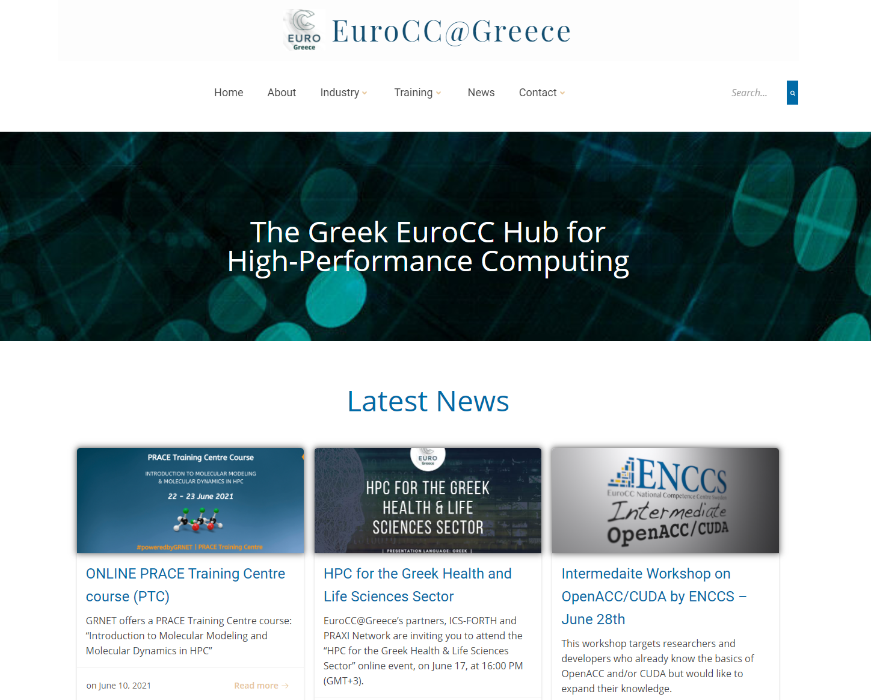
The EuroCC@Greece
Competence mapping
Training needs identification/ training provision/ skills development
Awareness/ dissemination
Collaboration with industry
Knowledge transfer

Slide 7
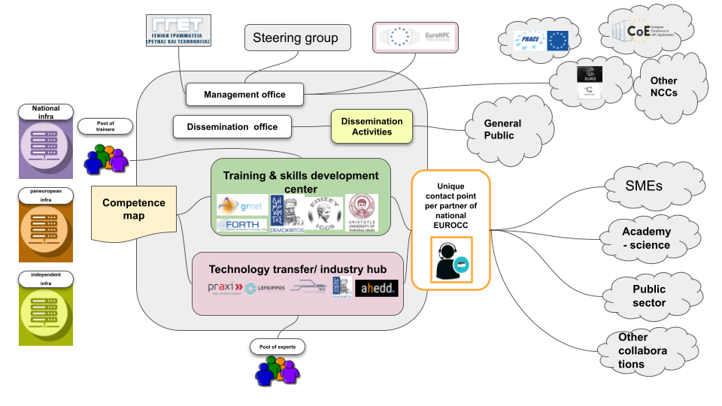

Slide 8

Stay informed and Connected!
Become part of our online community today and do not miss a thing

Slide 9

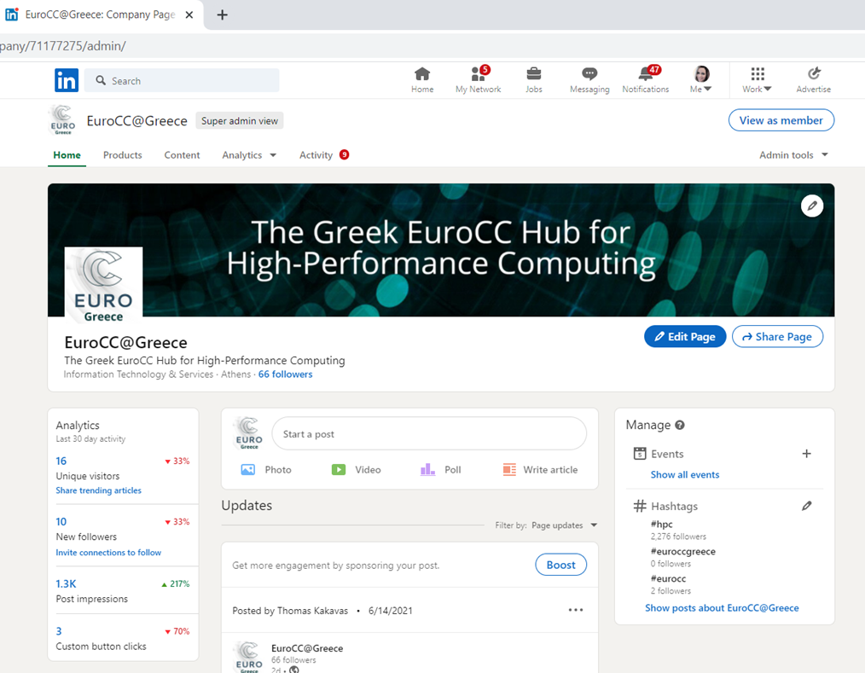
Twitter, LinkedIn accounts
Twitter: @EuroCC_Greece, LinkedIn: @EuroCC-Greece

Slide 10
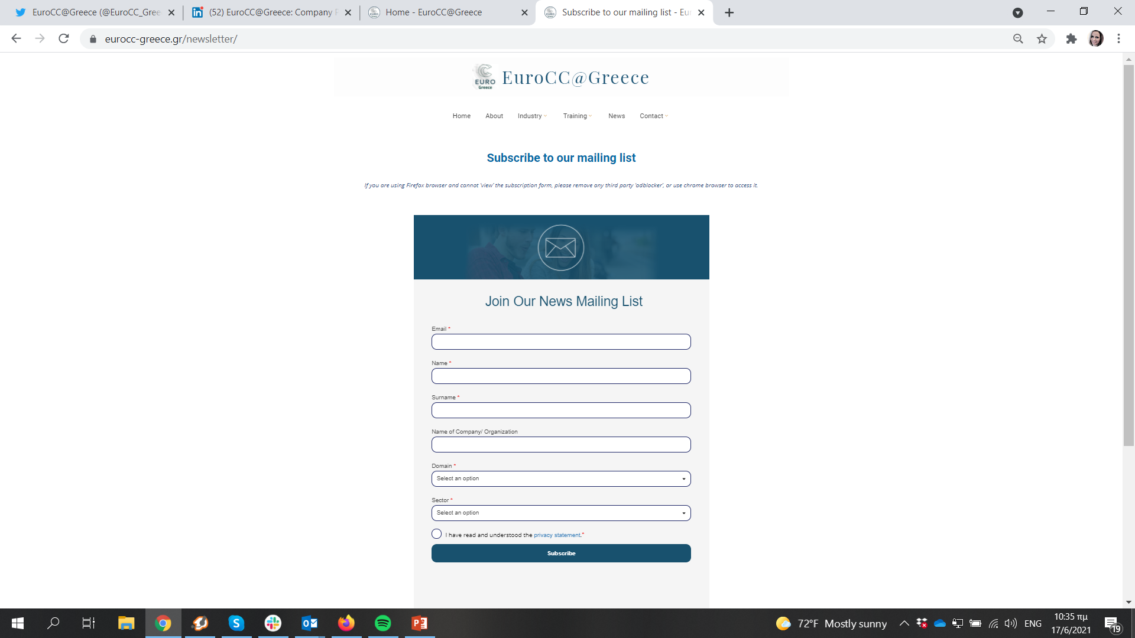
Subscribe: eurocc-greece.gr/newsletter
Stay informed and connected!

Slide 11
Consortium partners
The Greek National Competence Center “EuroCC@Greece”, is run by a consortium of 5 institutions, namely
GRNET – National Infrastructures for Research and Technology (coordinator),
National Centre for Scientific Research “Demokritos”,
Foundation for Research and Technology – Hellas (FORTH),
Institute of Communication and Computer Systems of NTUA
Aristotle University of Thessaloniki.
The project has received funding from the European High-Performance computing Joint Undertaking (JU) under grant agreement No 951732 and the Greek Secretariat for Research and Technology.

Slide 12
Mapping HPC, AI, HPDA Training in Greece
Supply
Training Mapping Survey in Greece 2021: HPC, AI, HPDA
421 distinct training programs
Online/Offline
Across all Greek Regions (22 cities)

Slide 13
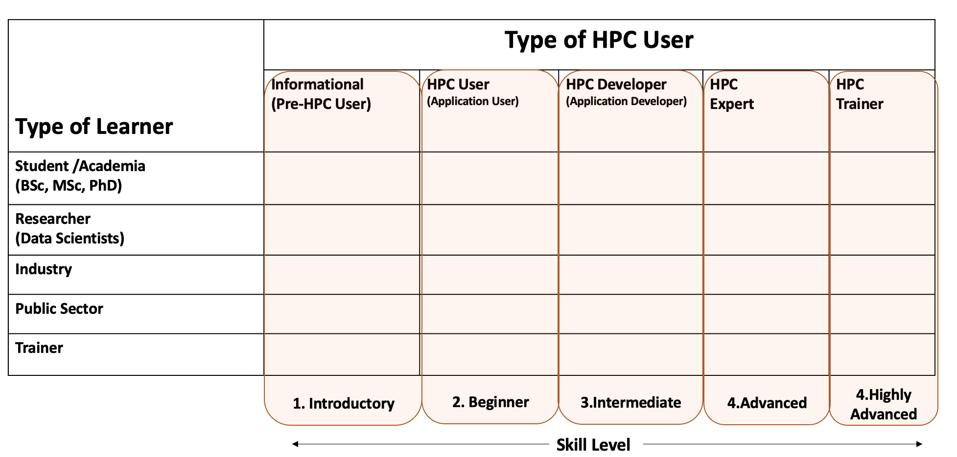
Training Mapping Framework
EuroCC@Greece (2021)

Slide 14
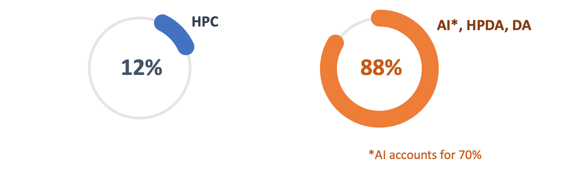
Training Mapping Survey in Greece: HPC, HPDA, AI
Thematic Areas
EuroCC@Greece (2021)
Notes:
© Copyright PresentationGO.com – The free PowerPoint and Google Slides template library

Slide 15
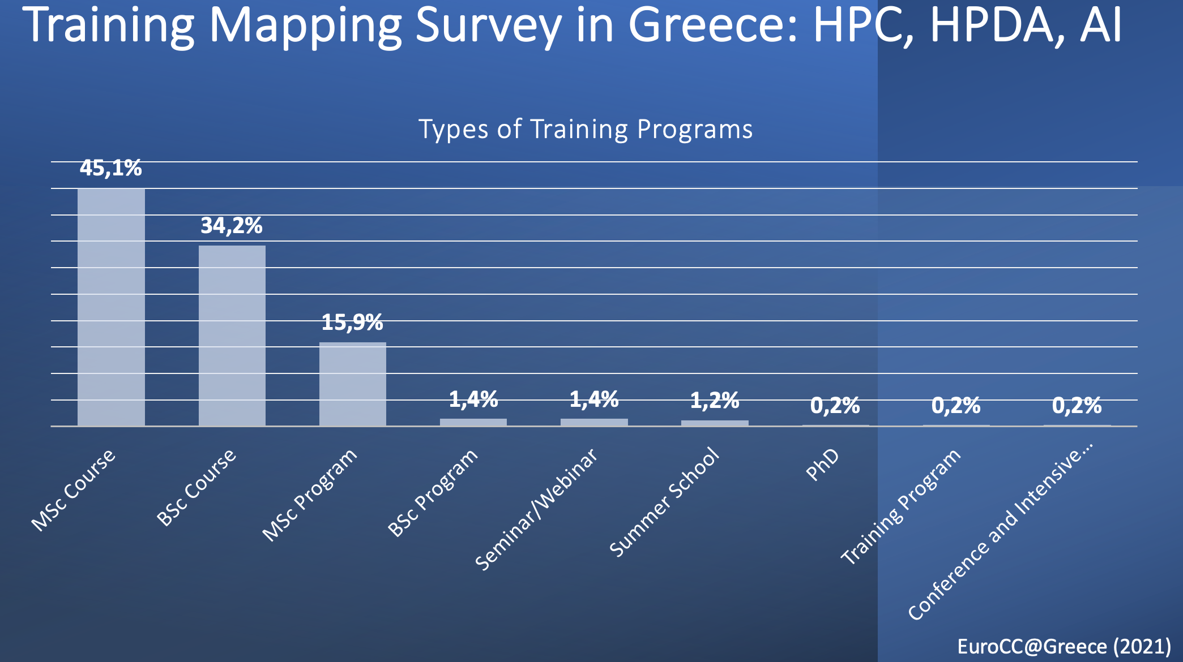

Slide 16
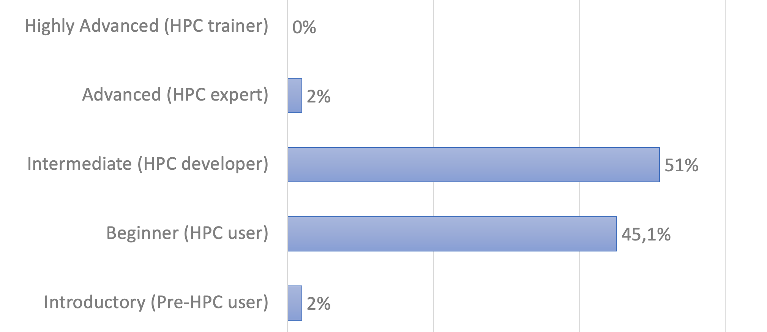
Training Mapping Survey in Greece: HPC, HPDA, AI
HPC Programs Overview
EuroCC@Greece (2021)

Slide 17
Training Mapping Survey in Greece: HPC, HPDA, AI
AI, HPDA Programs Overview
Highly Advanced
Introductory &
Beginner
Intermediate &
Advanced
EuroCC@Greece (2021)

Slide 18
Training Mapping Survey in Greece: HPC, HPDA, AI
HPC Programs Overview
EuroCC@Greece (2021)

Slide 19
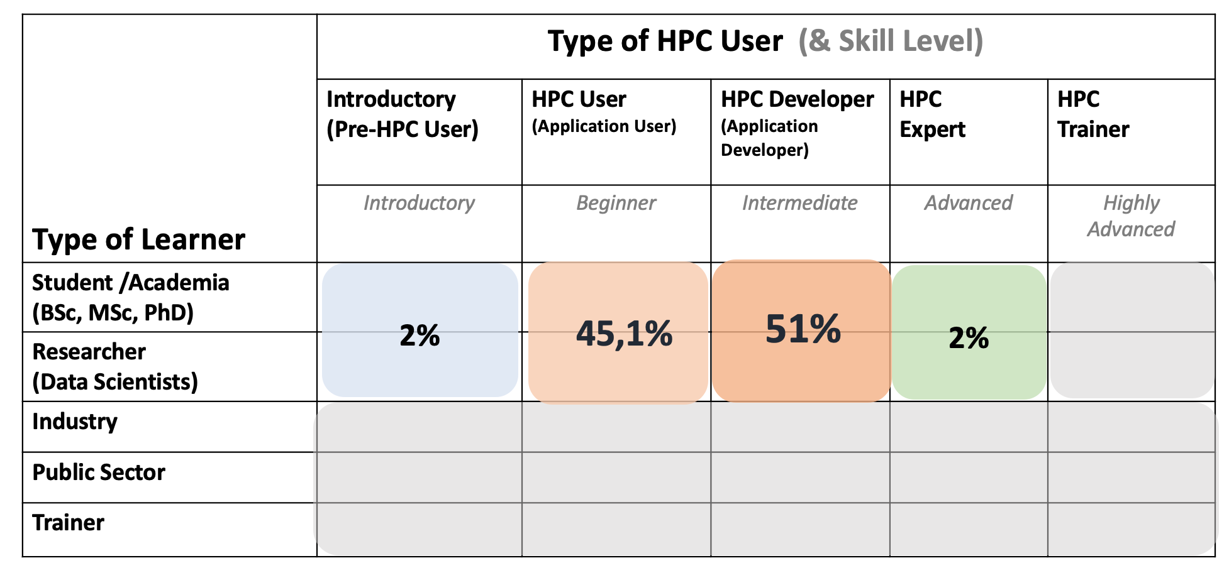
Mapping HPC, AI, HPDA training in Greece
EuroCC@Greece (2021)

Slide 20
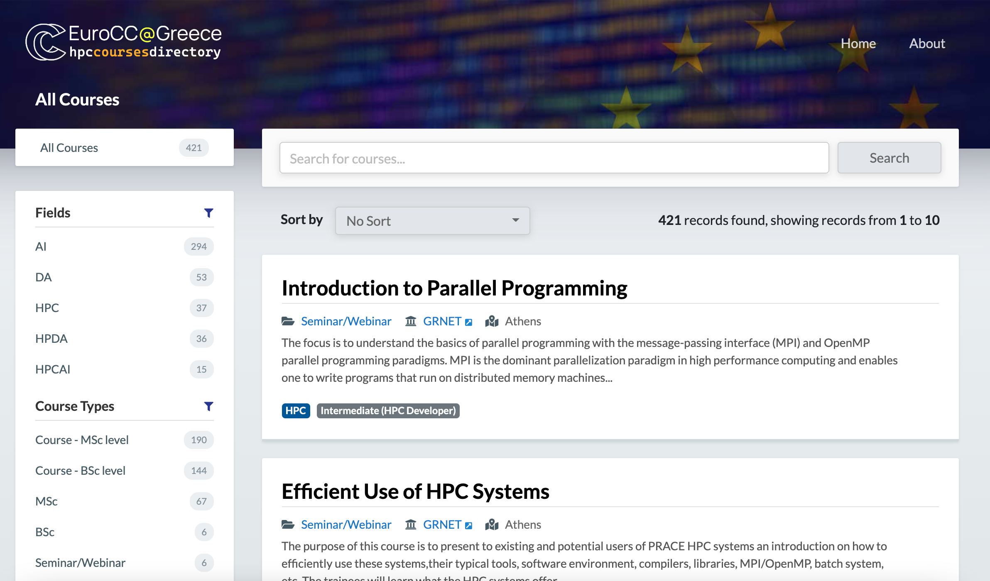

Slide 22
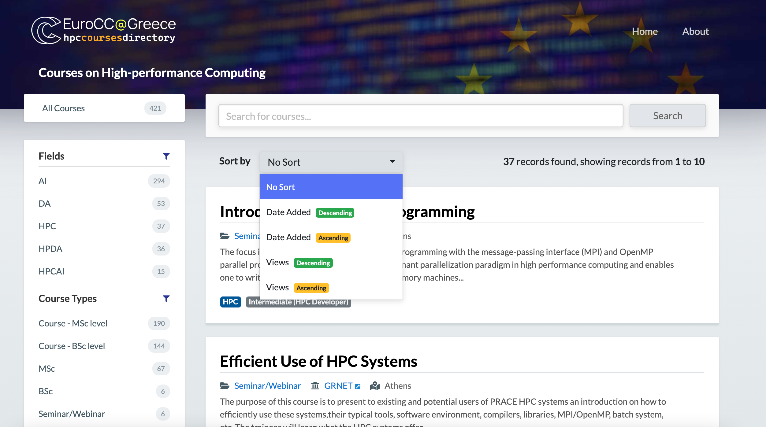

Slide 23
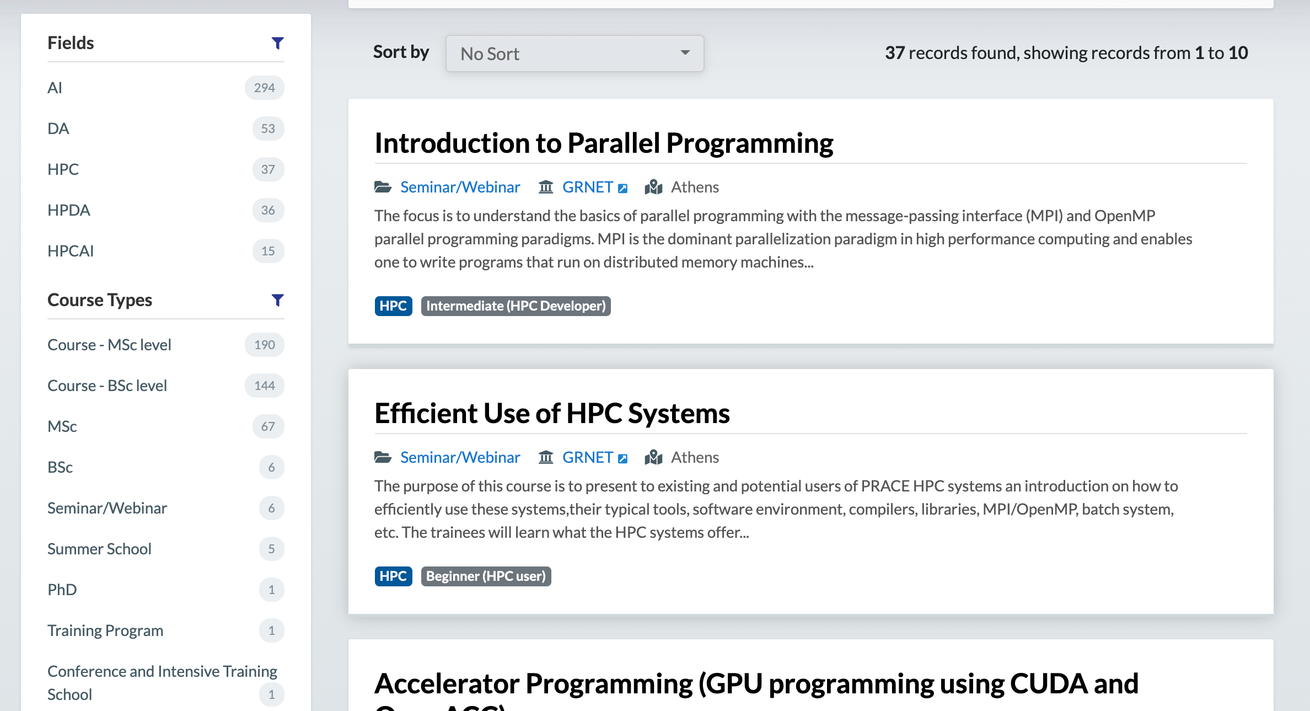

Slide 24
Mapping HPC, AI, HPDA Training in Greece
Supply
Training Mapping Survey in Greece 2021: HPC, AI, HPDA
Demand
Training Needs Survey for Greece 2021
Coming soon !
Design
Specialised
Training

Slide 25
EuroCC@Greece Database of HPC/BigData/AI providers
a database/register/marketplace/“μητρώο” supported by EuroCC@Greece
for...
  service providers
  independent experts
  public & academic organizations (e.g., with infrastructure, training programs)
  etc.
… that provide any type of HPC and/or Big Data and/or AI services

Slide 26
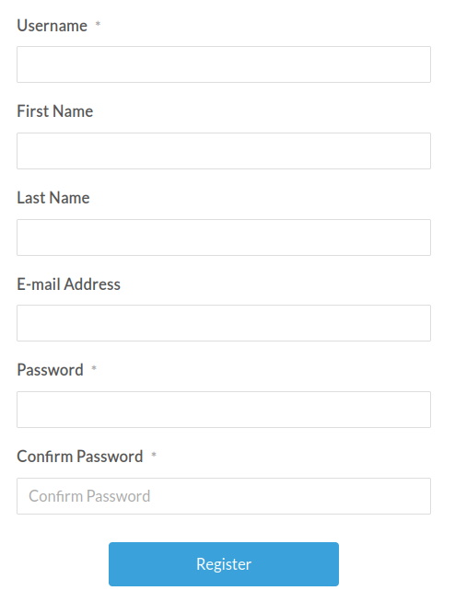
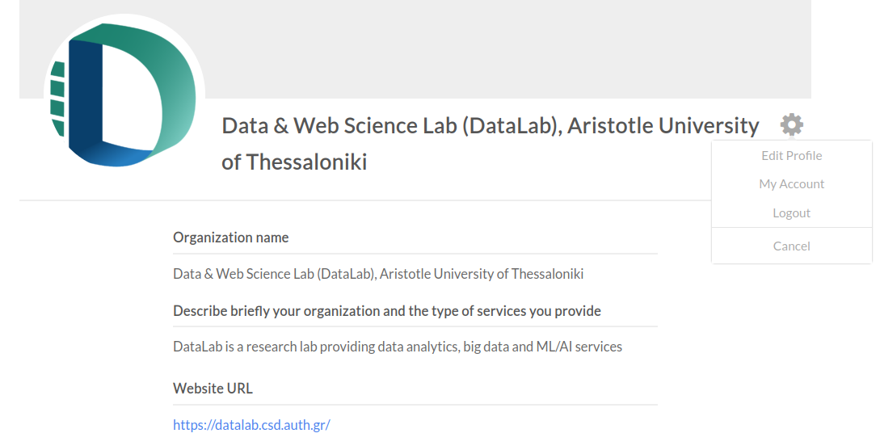
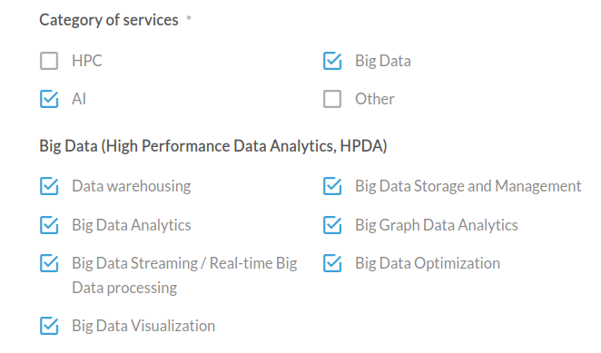
Register as a provider
a database/register/marketplace/“μητρώο” supported by EuroCC@Greece
for... Step 1: Create account as a provider (less than 1 min)
Step 2: Add information to your profile (less than 5 min)
  Organization data (name, website, type, etc)
  Domain of services (Life sciences, Engineering, IT, etc.) [checkbox]
  Type of services (infrastructure, software, consulting, etc.) [checkbox]
  Specific HPC / Big Data / AI services and technologies you provide [checkbox]
You’re done!

Slide 27
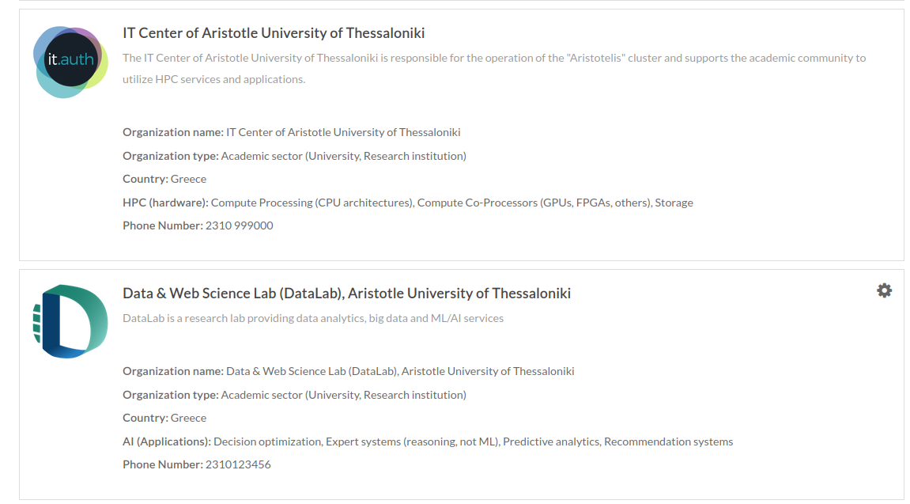
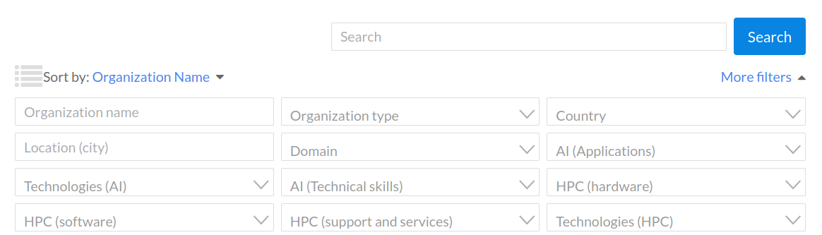
View providers (for users)
View a list of all registered providers
Filtered search (e.g., typo)
Select and view detailed info for a provider

Slide 28

Register now!
Register here: https://eurocc-mapping.web.auth.gr/

Slide 29
What’s in it for you?
Now | In the near future
Greek HPC resources/ user support training, Greece and Europe wide Centers of excellence Support for funding Access to expertise – find and be found/ marketplace | Access to very large pan European HPC resources, specialized by private and public users HPC Master course Self assessment tool

Slide 30
Stay informed and Connected!
Become part of our online community today and do not miss a thing

Slide 31
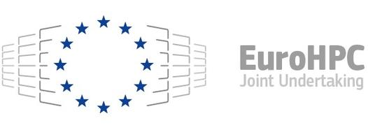
Thanks!
﻿This project has received funding from the European High-Performance Computing Joint Undertaking (JU) under grant agreement No 951732. The JU receives support from the European Union’s Horizon 2020 research and innovation programme and Germany, Bulgaria, Austria, Croatia, Cyprus, Czech Republic, Denmark, Estonia, Finland, Greece, Hungary, Ireland, Italy, Lithuania, Latvia, Poland, Portugal, Romania, Slovenia, Spain, Sweden, United Kingdom, France, Netherlands, Belgium, Luxembourg, Slovakia, Norway, Switzerland, Turkey, Republic of North Macedonia, Iceland, Montenegro

