Slide 1
EuroCC Workshop: HPC for the Greek Health & Life Sciences Sector 17 June 2021
Infrastructure Advisory Group
Overview & Industrial Working Group Findings
Dr. Zoe Cournia
INFRAG Industry Working Group co-Chair
Notes:
Hello, I am Zoe Cournia and together with my INFRAG Industry working gorup co-chair, I would like to welcome you to EuroHPC Workshop on Industrial User needs. In this introductory talk, we will introduce the aims of the workshop and briefly present the INFRAG Industrial Working Group Findings

Slide 2
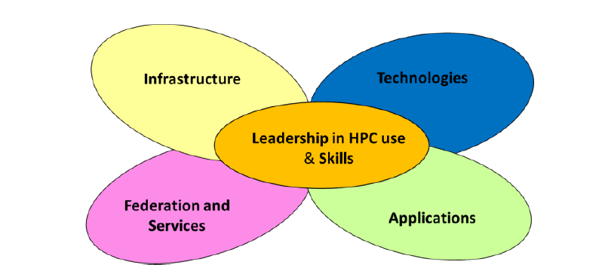
Outline
Industrial User Requirements
INFRAG Industry Working Group & Findings
Relation to MSA
INFRAG Industrial User Group Workplan
Notes:
The scope of this workshop is to address the Industrial User requirements, where we will hear the perspectives from Big Industry, SMEs, ISVs, and Community representatives. In this talk we will introduce the Industry working group of the Infrastructure Advisory Group of EuroHPC JU, the relation to the MSA and the INFRAG Industrial User Group Workplan, which is based in the five pillars of the MSA: Infrastructure, Tehcnologies, Federation and Services , applications, and Leadership in HPC use and skills.

Slide 3
Industrial User Requirements
Industry: Big Industry, SMEs, ISVs and Community Representatives play an integral role in EuroHPC dynamics
Industry is a very important part of European economy
Big Industry, SMEs, ISVs have very specific but also different requirements, especially because many of these users do not have skills in HPC
EuroHPC is setting up Competence Centres in every partner-state to provide permanent support to academic and industrial future users
Competence Centers will bring support to Applications and help industry users with HPC access.

Slide 4
Industrial User Requirements
Mastering HPC/HPDA in all its dimensions is decisive for European Industry in order to stay competitive in the global market so EuroHPC is preparing to:
Transfer knowledge between Research/Academia and European Industry
Develop a co-design approach between technology providers and advanced users
Take into account inputs from Industry Community, listing their specific needs and requirements
Such Requirements are taken into account in the MSA drafting

Slide 5
USER
ROADMAP
REQUIREMENTS
INFRASTRUCTURE ROADMAP
Science
Roadmap
(1-7-15 years)
Development of science
Definition of Require-ments
System-architecture
MULTIANNUAL STRATEGIC AGENDA
Software/
Application
Industry
Roadmap
(1-7-15 years)
Development of industry
User Support/Training
Access
Big
Industry
SMEs
Community Representatives
ISVs

Slide 6
INFRAG Industrial Working Group
EuroHPC Platforms will be open to both research and industry users
INFRAG (Infrastructure Advisory Group) has the mandate of EuroHPC JU governance to develop a proposal of how to organize the Industry User representation and take into account user inputs: research and industrial needs and requirements
INFRAG leads a Working Group to write a white paper gathering inputs provided by all national industrial user initiatives
This WG is currently composed of members of the INFRAG and external experts from Big Industry, SMEs, ISVs, and Community Representatives will also participate

Slide 7
INFRAG Industrial User Group
Members
Claus Axel Müller (Chair) | GCS | Germany
Daniel Verwaerde | TERATEC | France
Zoe Cournia | Academy of Athens | Greece
Sanzio Bassini | CINECA | Italy
Philippe Geuzaine | Cenaero | Belgium
Norbert Meyer | PSNC | Poland
Sergi Girona | BSC | Spain

Slide 8
Industrial user – MFF 2021-2027
HPC will have to be part of a fast-evolving environment:
User requirements:
Cloud-based / increased secure access
Short access times; quality and type of services provided; protection of IP, big data and innovation
Provide new computing and data applications and services including interactive computing & urgent computing
Provide training and user support and enabling facilities
Evolution of supercomputing technologies
HPC/AI/Cloud Convergence
The computing continuum (from IoT/fog/Edge to HPC)
Links to the European Data Spaces
Notes:
EU's multiannual financial framework (MFF) for 2021-2027.

Slide 9
Industrial end-user – next EuroHPC JU regulation (1)
Wide participation of User industry to HPC facilities and application related capability building:
Adaptation and deployment of industrial/sectorial HPC tools
Codes & software environments
HPC services/tools with particular focus on medium/SMEs HPC to increase their innovation capability
Enhanced role for National HPC Competence Centres
Industry Training & Skills Development

Slide 10
Industrial end-user – next EuroHPC JU regulation (2)
Access to and use of the EuroHPC infrastructure
Fostering Industry access to EuroHPC computing and data services: cloud-based secure service platforms/ gateways for user industries
Access of User Industry to EuroHPC infrastructure:
Free access for public R&D and for business innovation purposes
Pay per use access (market conditions) for commercial purposes
Dedicated EuroHPC Infrastructure for industry
Industry access to services provided by EuroHPC JU systems
Acquisition of dedicated machines for industry
➔ JU ownership or co-ownership of such machines with the Industry Players

Slide 11
Next steps
Starting point is EuroHPC project Castiel/EuroCC:
Coordination of national activities
Platform for exchange of best practices
First Milestone: competency map
Enhance role for User Industry in the EuroHPC
Multiannual Strategic Agenda (MSA) /guideline/catalogue of managed services for industry
Connectivity, computing, IT-security, data processing, development, support, workflow, certification, exploitation (go to market)
Pro-active communication to potential users, dedicated workshops with Users from Industry
Pilot new systems including industrial users testing
Define European cyber security strategy, critical for industrial applications
Co-design strategy should be based on developing partnerships with industry
A bridge between GAIA-X and EuroHPC has high potential to support commercial access to computer requirements from Industry

Slide 12
Industrial User Group Action Points
List of external experts for Industrial Users WG finalised by INFRAG members.
Organising the Industrial Users workshop during the EuroHPC Summit Week 2021. Invite Industry representatives to participate and gather input by all national industrial user initiatives
Communication with relevant activities ETP4HPC, Competence Centers, EOSC
Draft white paper for industrial user requirements based on the MSA pillars

Slide 13
Thank you for your attention
EuroHPC Workshop on
Industrial User Needs
EuroHPC Summit Week
23 March 2021

