Slide 1


HPC in biomarker and drug target discovery:
a success story in promoting
Cancer Drug Accuracy

Slide 2
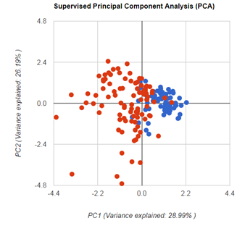
Classifier - Biomarker – Biosignature
(molecule, feature, cluster)

Slide 3
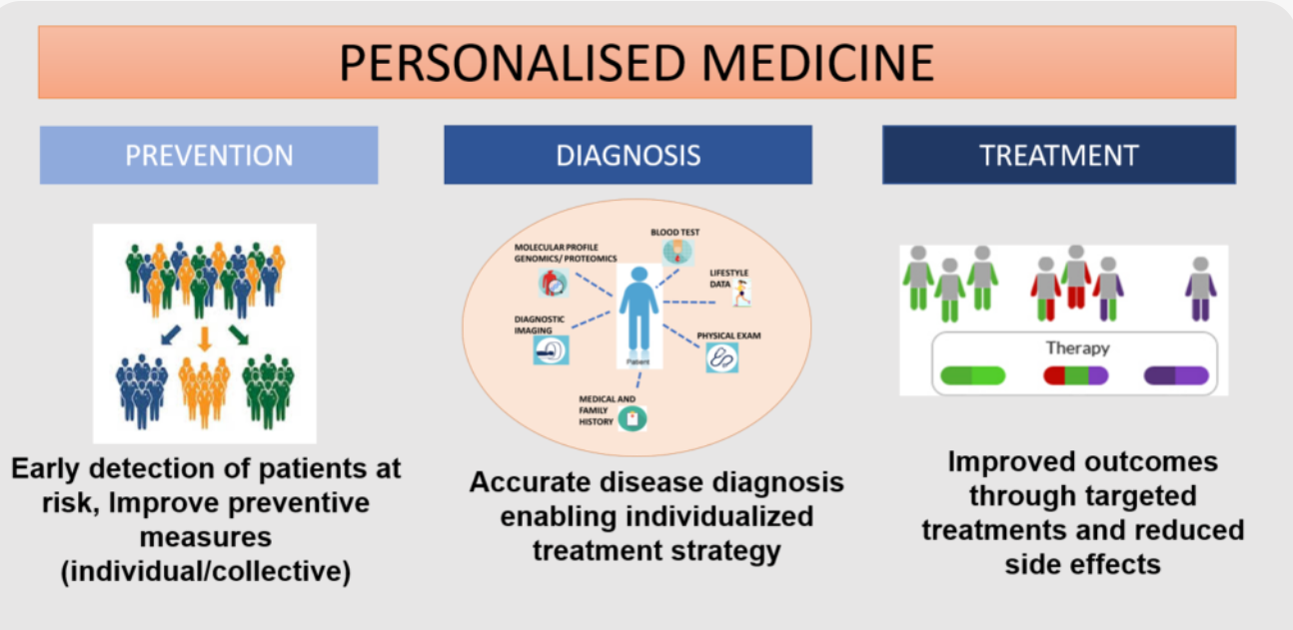
What is it?
Precision medicine (PM) is a medical model that proposes the customization of healthcare, with medical decisions, treatments, practices, or products being tailored to a subgroup of patients, instead of a one‐drug‐fits‐all model.^{[1][2]} In precision medicine, diagnostic testing is often employed for selecting appropriate and optimal therapies based on the context of a patient’s genetic content or other molecular or cellular analysis.^{[3]} Tools employed in precision medicine can include molecular diagnostics, imaging, and analytics.^{[4][5]}
Notes:
What is it? Why it is important
3

Slide 4
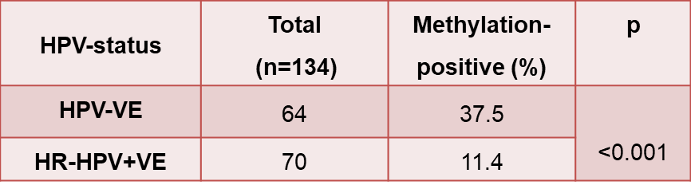
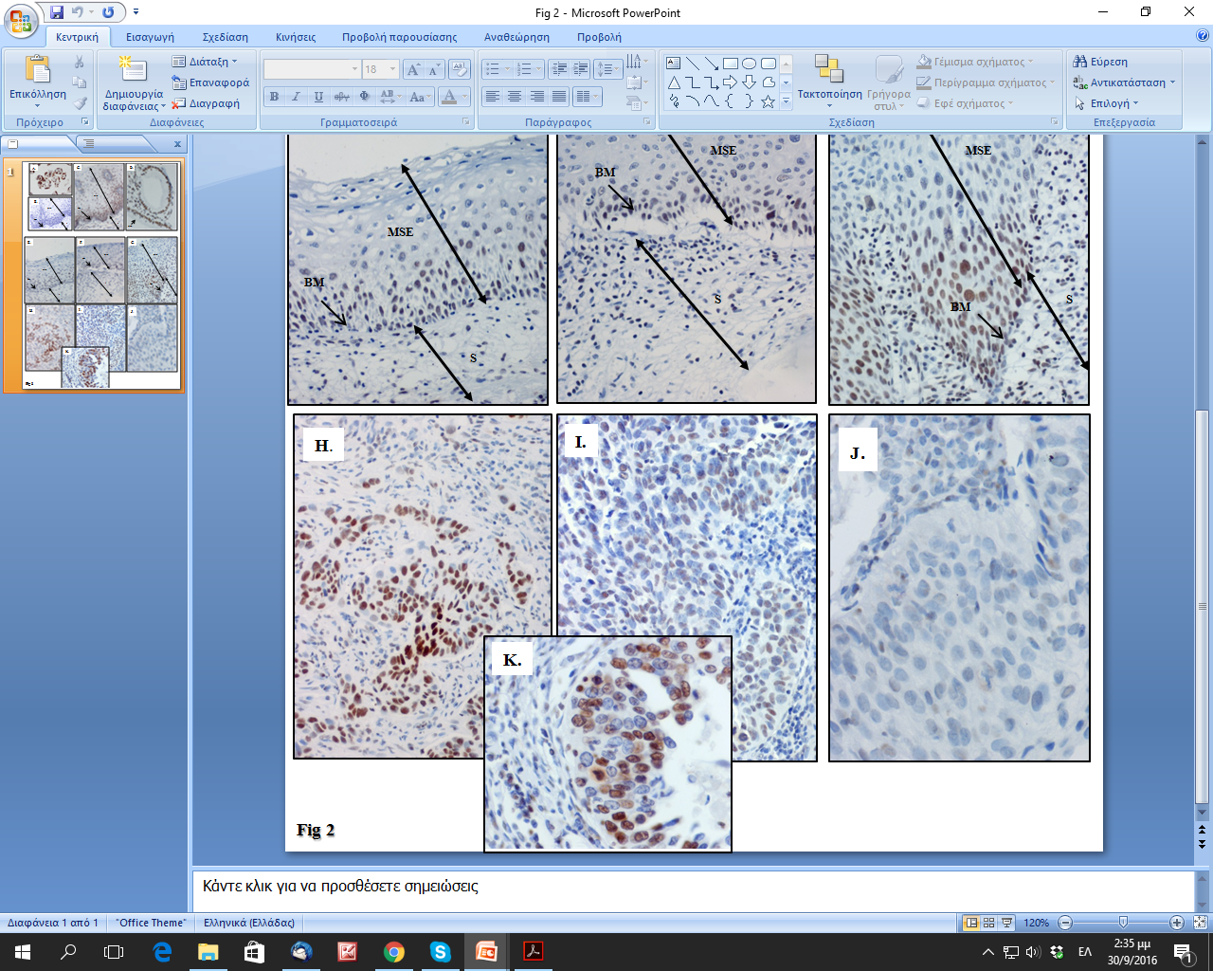
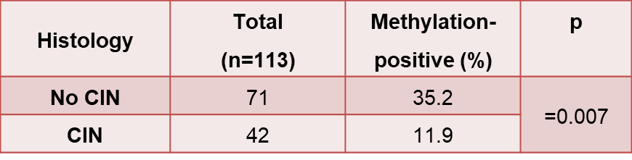
Cancer:
- Identification of epigenetic biomarkers.
Contribution of epigenetic alternations in carcinogenesis:
ex vivo and in vitro studies.
Gene promoter methylation and protein expression of BRMS1 in uterine cervix in relation to high-risk human papilloma virus infection and cancer. Panagopoulou et al., 2016.
Cervical cancer
Grade I
Grade III
Metastasis suppressor gene BRMS1 was less frequently methylated in cervical smears of women infected by HR-HPV and pre-cancerous lesions. It was also more frequently methylated in advanced cancers resulting in lower protective protein expression in the more aggressive low differentiation cancer blasts: diagnostic tool for the triage of HR-HPV infected women.
Panagopoulou et al., Tumor Biology 2017
Notes:
4

Slide 5
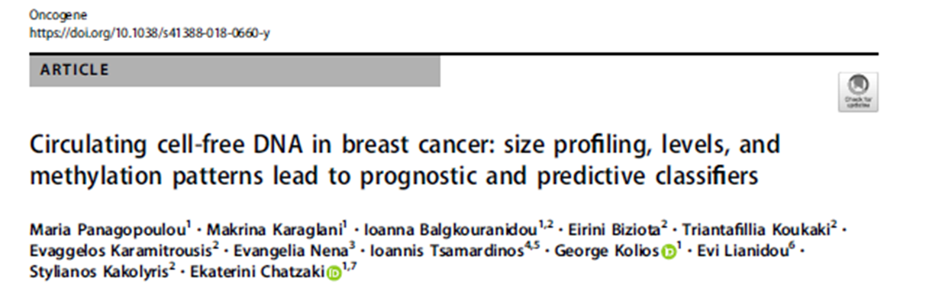
Multiple features ccfDNA in breast cancer: development of multivariate prognostic/predictive classifiers based on quantitative, qualitative and epigenetic characteristics
Experimental measurements for the: 1. quantification of ccfDNA, 2. DNA methylation of SOX17, WNT5A, MSH2, KLK10 and GATA3 in ccfDNA by qMSP.
Breast Cancer groups (Department of Medical Oncology, UHA)
Adjuvant: 150 patients having undergone surgery for primary breast cancer, before the initiation of adjuvant therapy.
Neo-adjuvant:16 patients with primary breast cancer, before the initiation of neo-adjuvant therapy.
Metastatic:34 patients with metastatic breast cancer before the initiation of 1st line treatment (a combination of taxanes & anthracyclines)
Control 35 healthy age-matched women (Blood Donation Unit, UHA)

Slide 6
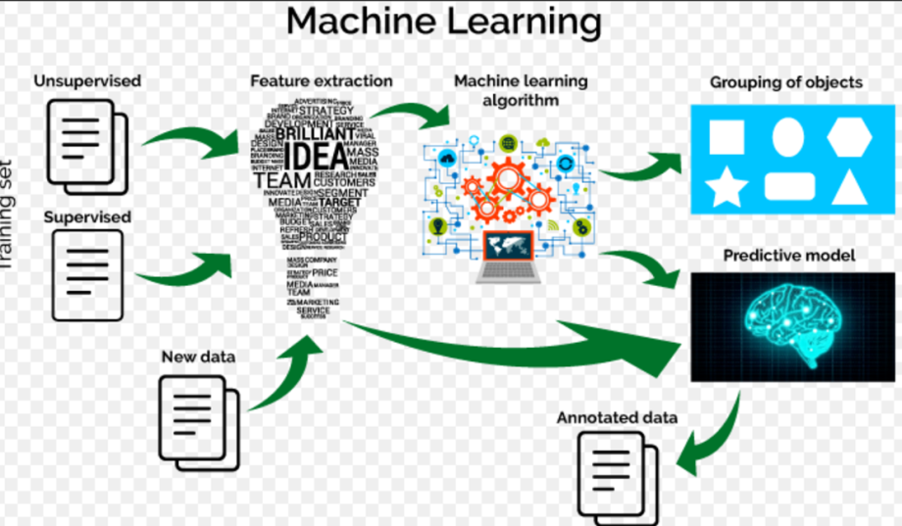
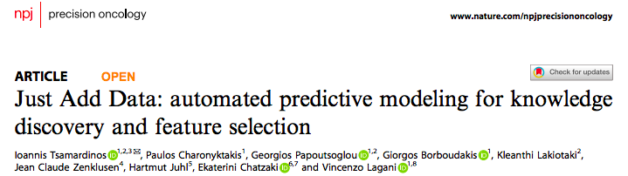
Classification analysis by automated Machine Learning
Most Machine learning approaches adopt own built algorithms
We used an autoML tool (jadbio.com/):
- specially designed for high-dimensional low sample biomedical datasets
- delivers optimal models/classifiers of few selected features, easy to be translated to multiplex assays, and few equal alternatives
- no complex code-difficult to be reviewed and replicated
- shields against common methodological analysis pit-falls such as over fitting
- does inform biology
Notes:
The group of Prof. Tsamardinos has developed this tool for non-experts and together we have shown its applicability in a variety of biological datasets and use cases, some of which I will be presenting later.
JADBio for optimal biosignatures
- requires no bioinformatic expertise, no complex code-difficult to be reviewed and replicated
- delivers models/classifiers of few selected features, easy to be translated to multiplex assays
- does not bear overfitting, reflecting in stable predictive strength in the validation steps
- does inform biology
- analysis outputs ready for the manuscript
6

Slide 7
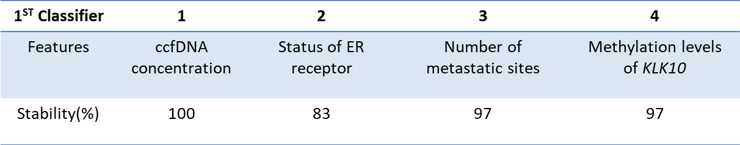
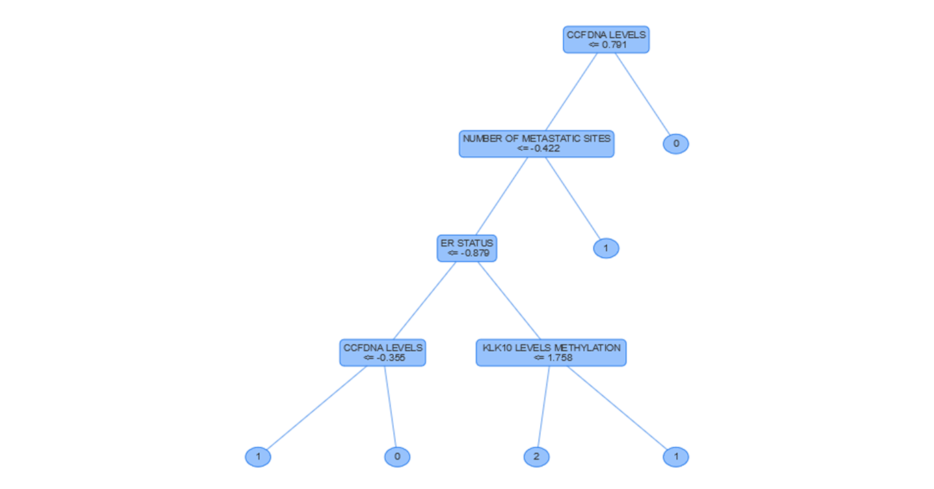
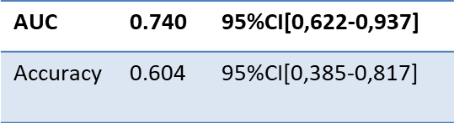
Prediction of 1st line treatment response in 1st clinical check (metastatic disease)
Clinical end-points:
Progression Disease(PD):0
Partial Response(PR):1
Stable disease(SD):2
Decision tree

Slide 8
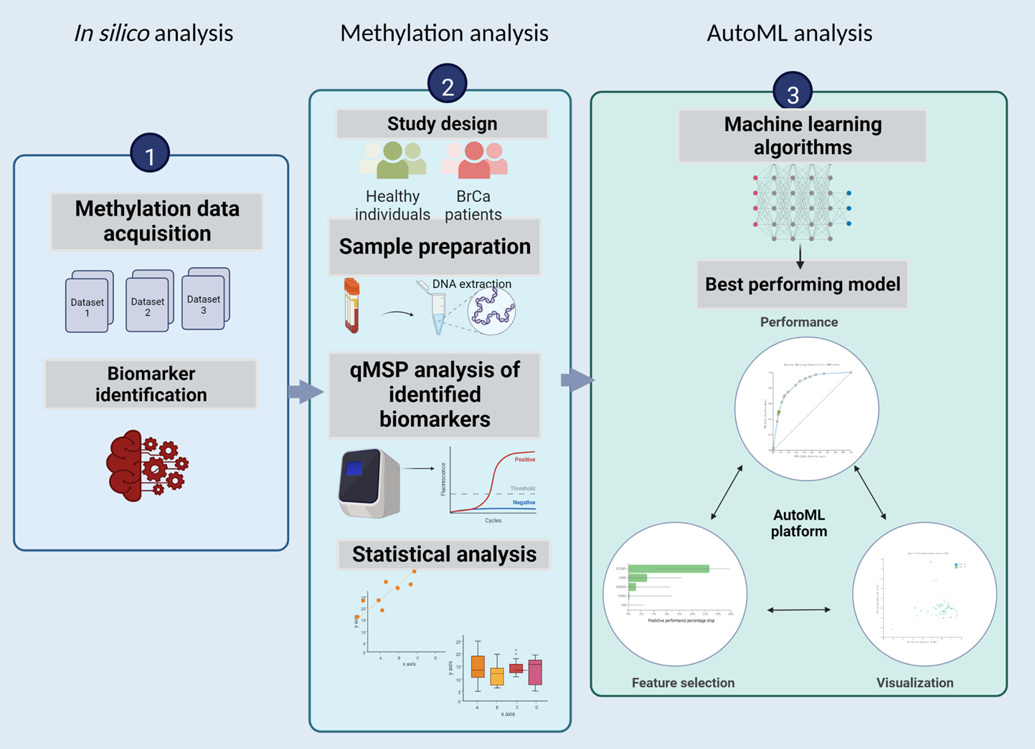
Switch from hypothsis to data-driven study design – the pipeline
AutoML – text mining
An effective AI-aided Pipeline for novel biomarker and drug target discovery.
Chatzaki et al., : A data-driven approach employing automated Machine Learning reveals novel liquid biopsy methylation biomarkers for breast cancer.

Slide 9
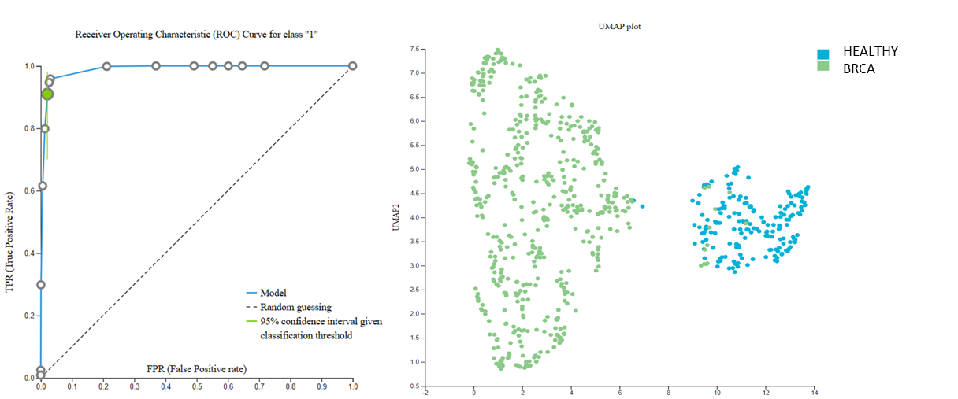
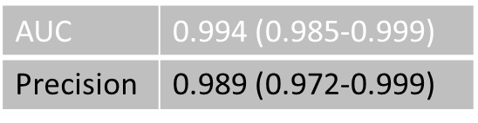
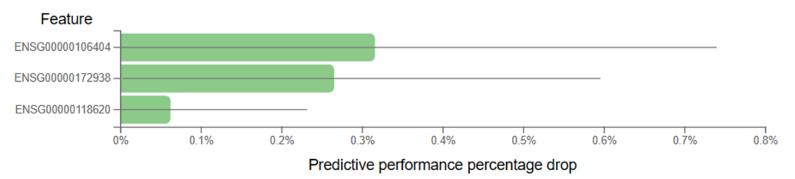
Results
A 3-feature BrCa specific biosignature was built via Ridge Logistic Regression algorithm,
high performance in distinguishing BrCa from healthy breast.
Methylation of 3 genes novel for BrCa:
CLDN15 (the coding gene of Claudin-15, a protein related to Blood-Brain Barrier, immune cell transmigration and Tight junction)
MRGPRD (the coding gene of MAS Related GPR Family Member D protein related to G protein-coupled receptor activity)
ZNF430 ( the coding gene of Zinc Finger Protein 430 involved in transcriptional regulation and nucleic acid binding).
- Literature mining revealed nearly no previous report of these genes in relation to BrCa.
A
B
A) ROC Curve & B) UMAP plot shows discrimination between healthy & BrCa tissues
CLDN15
MRGPRD
ZNF430

Slide 10
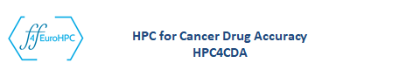
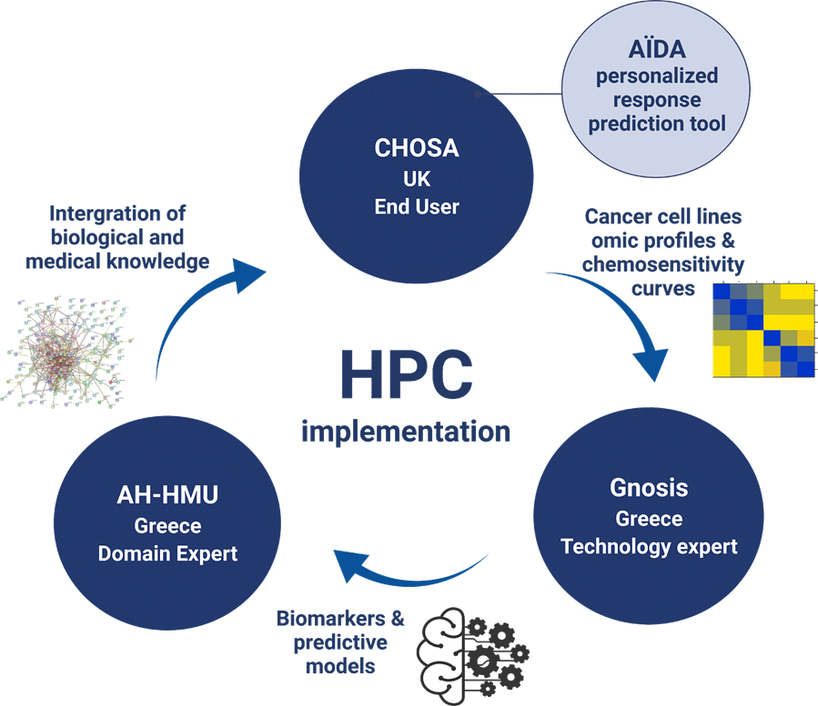
SIZE MATTERS: NEED FOR HPC…

Slide 11

The Problem, Challenge and benefit of HPC
The doctor has little help in choosing between > 300 approved anticancer drugs for cancer treatment. Modelling of chemosensitivity data can drive the choice of the right drug to the right patient at the right time = personalized medicine.
In this project HPC enabled:
an extensive analysis of a huge volume of publicly available chemosensitivity omics data
by a state-of-the-art AI platform using automatic machine learning: JADBio
to develop a tool for drug response prediction.
This first-in-market product that can truly revolutionize the way cancer patients are treated.

Slide 12

- NCI-60 program has screened over 100,000 compounds over 60 human cell lines representing nine types of cancers
dosage-response profiles, GI50
multi-omics profiling (transcriptome, proteomes, and other).
"[...] around 60.000 computing jobs around 1.200.000 core-hours. …
Collected experiments with data on >100K compounds
After filtering, we got 10K high-quality experiments on 6K compounds
Analysis returns signatures, best model, performance estimates and out-of-sample predictions, alternative features.
Outcomes:
Predictive sensitivity biosignatures for each compound or cluster
Pancancer sensitivity features
Sensitivity features inform biology
Targets to reverse or increase sensitivity
…..

Slide 13
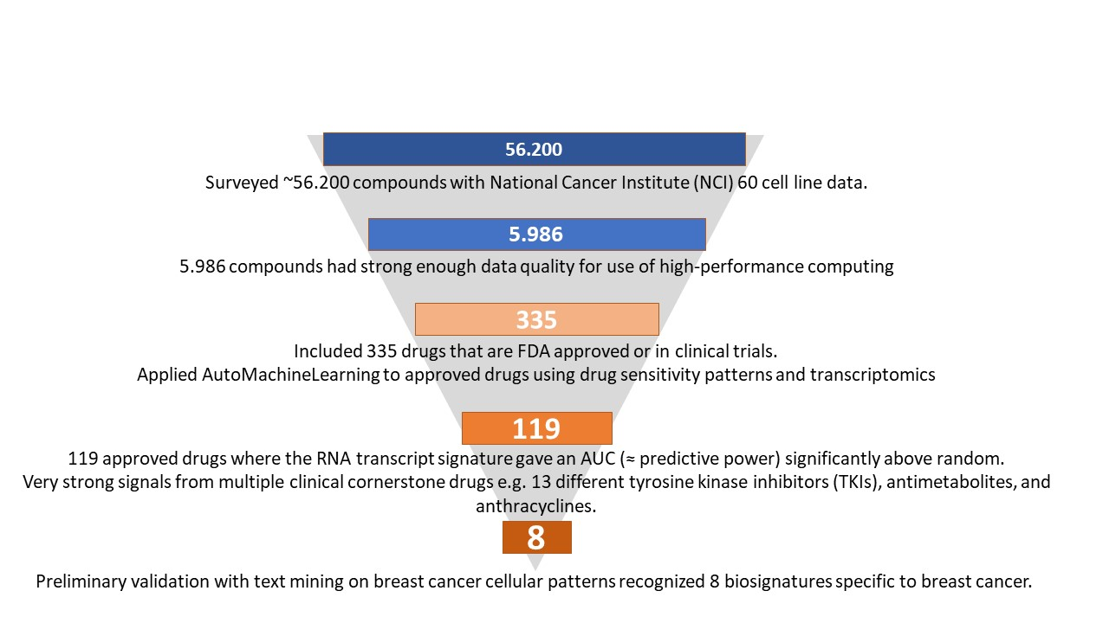

Slide 14
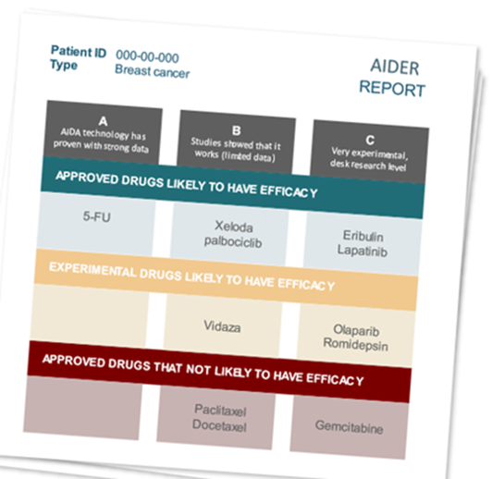
Value, Deviations, Lessons
HPC enabled big data handling to develop clinically relevant competitive solutions.
We succeeded in executing > 30,000 computational experiments for 5,986 compounds, 335 response prediction biosignatures, 119 highly effective
8 biosignatures perform highly in breast cancer enter clinical validation
CHOSA will launch a service (~€3K per analysis) to drive choice of treatment: a drug report list/patient highlighting those drugs most likely to work.
Secured funding for further refinement of the models and high interest in business community for the business case.

Slide 15
Benefits of FF4EuroHPC
Benefits
Time saving: AI-aided biosignature building delivers mature clinically relevant solutions.
HPC allowed for comprehensive analyses of all public data from National cancer institute for patterns of drug sensitivity.
More cancer patients with limited disease get the right treatment which is potentially lifesaving.
More cancer patients with advanced disease will live longer as they avoid ineffective treatment.
Expected launch market of 23,000 annual newly diagnosed breast cancer patients, gross annual revenue is then 69 million € in Germany and Nordic countries alone.

Slide 16

VAT: 801897134
Email: info@abcured.com
abcured.com

Slide 17
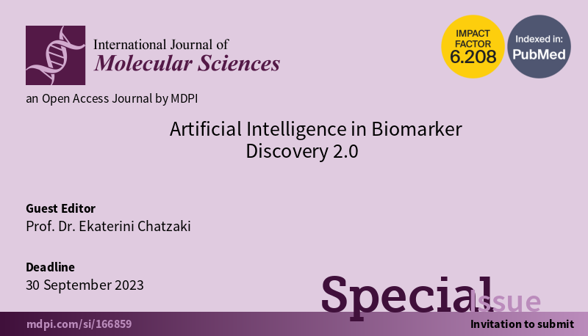
THANK YOU
Ekaterini Alexiou Chatzaki
achatzak@med.duth.gr

